Slide 1








DIGITAL. INNOVATION. SCALE

Slide 2

Agenda
Visitor design patterns
What is Visitor Design Pattern
When to use
Examples
Questions and answers

Slide 3
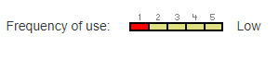
What is Template Method Design Pattern
Behavioral Design Pattern
Represent an operation to be performed on the elements of an object structure. Visitor lets you define a new operation without changing the classes of the elements on which it operates.

Slide 4
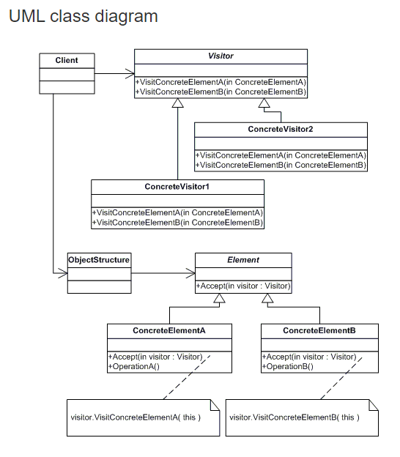
What we need for Visitor Design Pattern
Visitor
ConcreteVisitor
Element
ConcreteElement
Object Structure

Slide 5
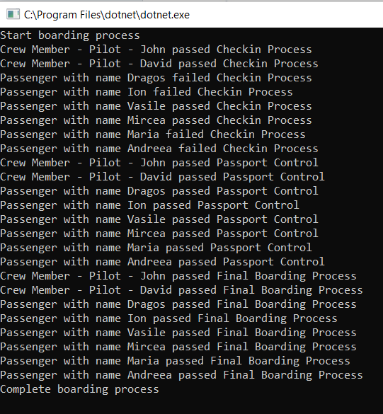
See Result

Slide 6
Questions

Slide 7
References
GOF – Design Patterns - http://www.w3sdesign.com/GoF_Design_Patterns_Reference0100.pdf
Dotfactory - https://www.dofactory.com/net/design-patterns
Code example -https://gitlab.softvision.ro/enterprise.net/design-patterns/command

